Slide 2
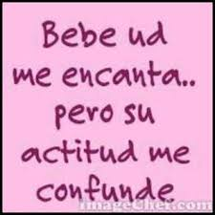
Notes:
Me confunde = it confuses me
It= actitud

Slide 3
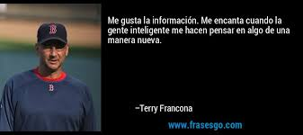
Notes:
Me hacen pensar = they make me think

Slide 5
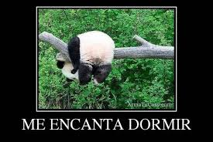

Slide 6
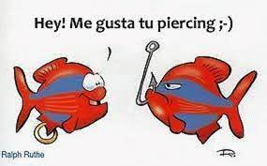

Slide 7
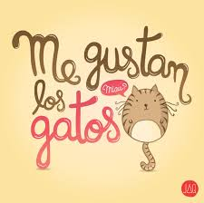

Slide 8
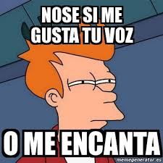

Slide 9
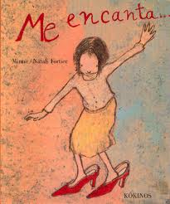

Slide 10
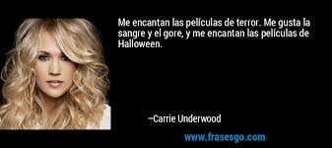
Notes:
Call attention to the fact that “gusta” is singular even when there are two nouns (or more) that come after…,”el sangre y el gore” if the noun that immediately follows is singular.

Slide 12
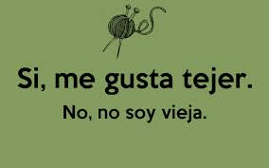
Notes:
Tejer – to knit

Slide 13
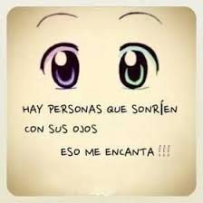
Notes:
Presta atención – conjugation of sonreir and “eso me encanta” “it = me encanta”

Slide 15
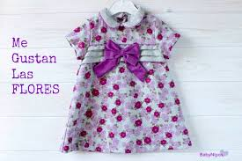

Slide 16
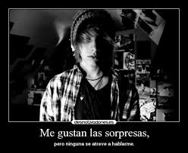

Slide 17
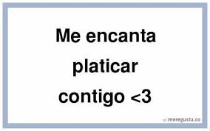
Notes:
Platicar = Hablar

Slide 18
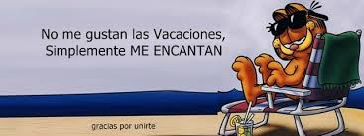
Notes:
Vacaciones = always plural

