Slide 1
ACTFL Proficiency Guidelines
An overview of leveling categories

Slide 2
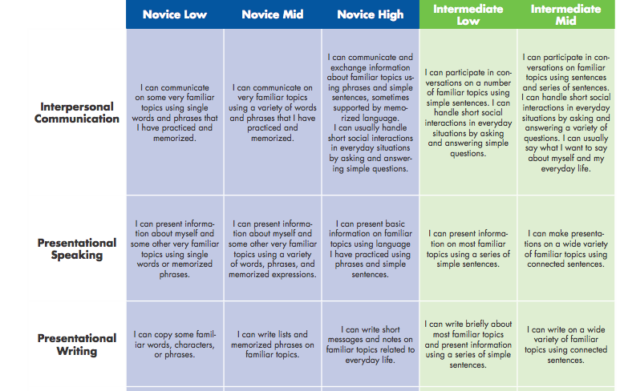

Slide 3
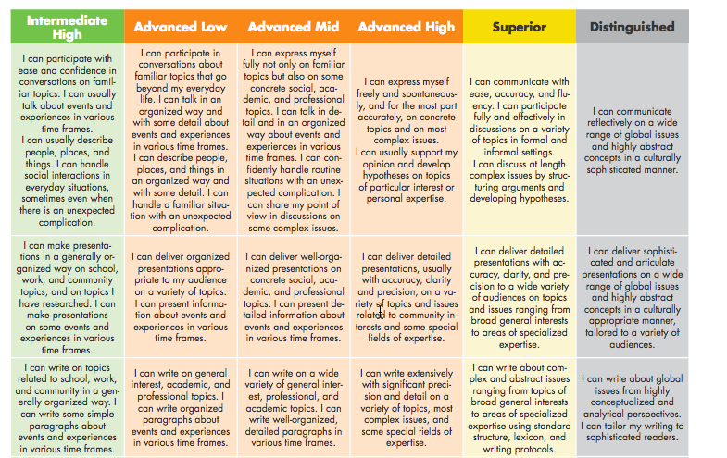

Slide 4
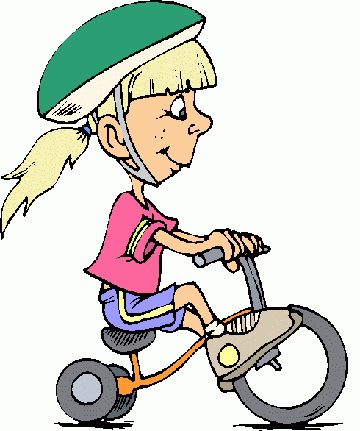
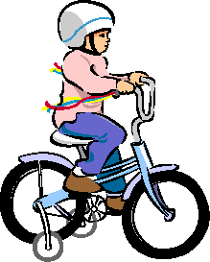
Which 3 levels do these pictures represent (the 3 we will see the most)?
Notes:
Targets essential: how do you know performance aiming for ? Allows specific fdbk to ss
If you don’t have target, can analyze assessment data to help set the
m
Developmental level of students; Amount of language study
Reference Tims

Slide 5
Novice
Respond to simple questions
Use:
isolated words
lists of words
memorized phrases
some personalized re-combinations of words or phrases
Ask memorized, formulaic questions
Satisfy immediate needs
WORD level
Notes:
Teacher understanding
Students & other stakeholders understandingACTFL
Esssential understanding

Slide 6
Intermediate
“Conversation” partner in simple, direct conversations
Describe and narrate
Ask and answer simple questions
Handle survival language
“Create” with language
SENTENCE level, but often strings of sentences

Slide 7
Advanced
Participate actively in conversations, formal and informal settings
Describe & narrate in major time frames, good control
Use variety of communicative devices to deal effectively with unanticipated complications
Sustain communication with paragraph length connected discourse, accuracy and confidence
Satisfy demands of work/school situations
PARAGRAPH level

Slide 8
Within each level is Low, Mid, and High……
How do we decide among them?

Slide 9
Low= Just barely hanging on

Slide 10
Mid = solidly within that level (with peaks of next level)

Slide 11
High = Fallen Angel
(student functions at the next level more than half of the time with specific patterns of breakdown)

Slide 13
Novice Low
I can copy some familiar words, characters, or phrases.
Repetitive words and phrases for common objects and actions
Simple words
Understood with great effort
Grammar, word order and word choice errors prevent communication

Slide 14
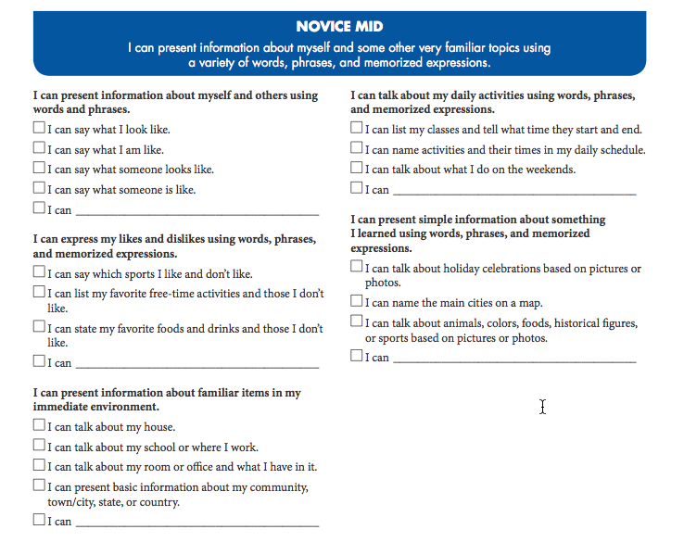

Slide 15
Novice Mid
I can write lists and memorized phrases on familiar topics.
Limited number of words and phrases
Occasional sentences
Understood with difficulty
Grammar, word order and word choice errors prevent communication

Slide 16
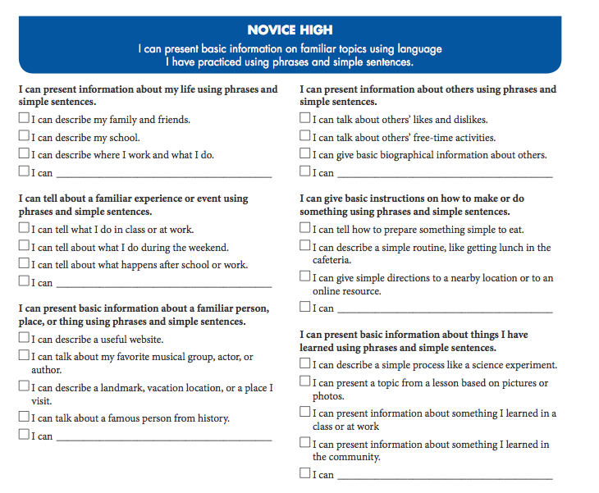

Slide 17
Novice High
I can write short messages and notes on familiar topics.
I can elaborate a little
Begin to combine words and phrases to create original sentences
Mostly understood by someone accustomed to a language learner
Grammar, word order, and word choice errors often prevent communication

Slide 18
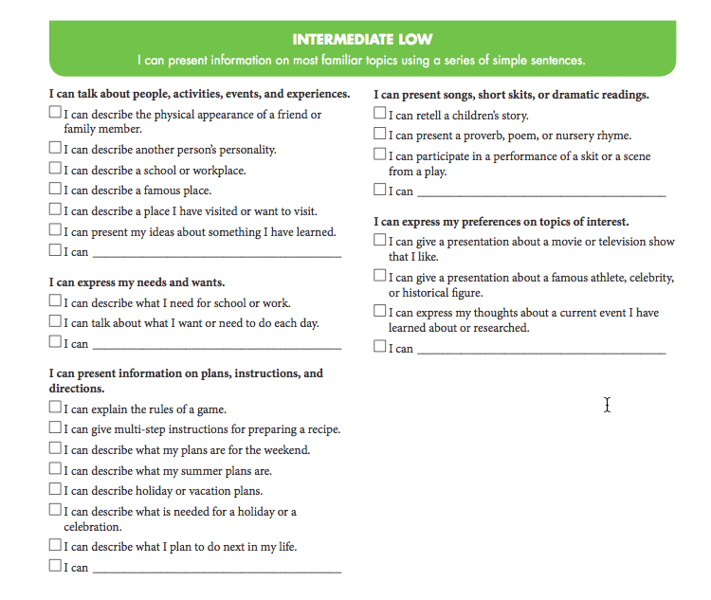

Slide 19
Intermediate Low
I can write briefly about most familiar topics and present information using a series of simple sentences.
Use a variety of words and phrases on a range of topics, begins to give detail and elaborate
Strings of sentences, combine words and phrases to create original sentences
Can be understood by someone who is accustomed to language learner
Grammar, word order, and word choice errors sometimes prevent communication

Slide 20
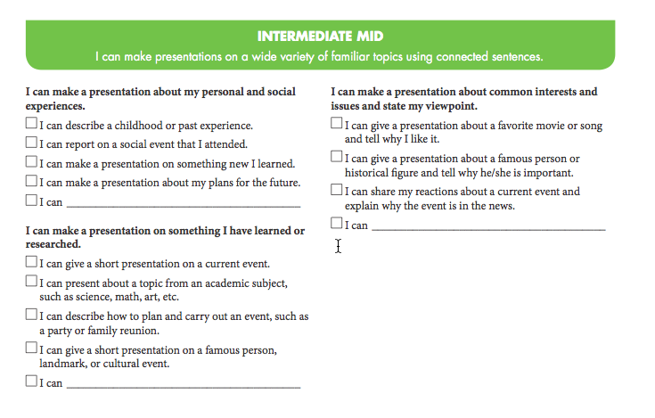

Slide 21
Intermediate Mid
I can write on a wide variety of familiar topics using connected sentences.
Begin to use expanded vocabulary within a topic/give details and elaborate
Strings of sentences to describe or explain
Uses connector words to create original sentences
Easily understood by someone accustomed to a language learner
Grammar, word order, and word choice errors do not prevent communication
Can express the present and at least one other time frame consistently, evidence of control over verb conjugations.

Slide 22
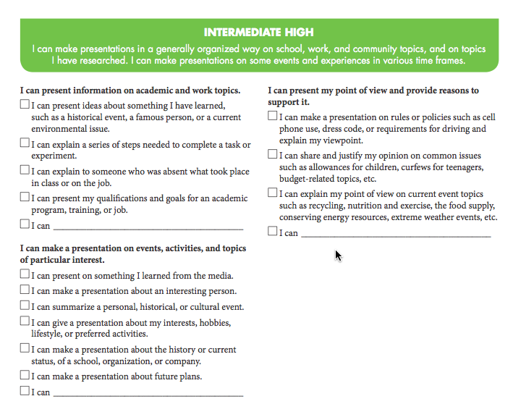

Slide 23
Intermediate High
I can write on topics in a generalized way. I can write some simple paragraphs about events and experiences in various time frames.
Consistently use words and expressions to communicate ideas on wide range of topics with expanded vocabulary
Uses connected sentences to narrate, describe or explain.
Begins to communicate in paragraph length
Generally understood by someone accustomed and those unaccustomed to language learners
Grammar, word order, and word choice errors do not prevent communication
Can use multiple verb tenses consistently and has control over them most of the time.

Slide 24
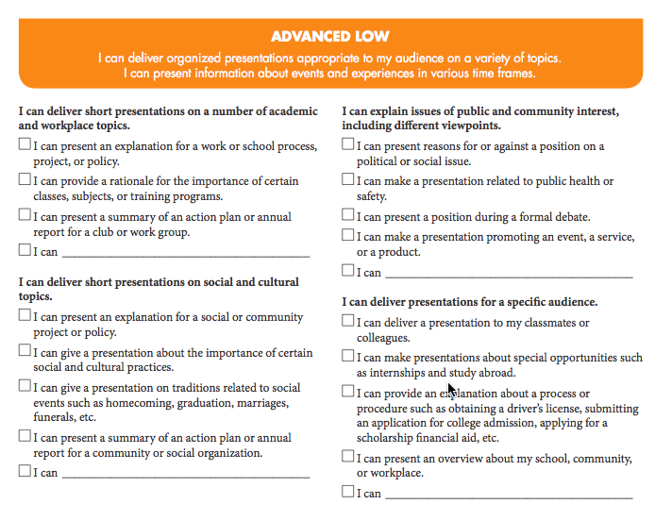

Slide 25
Advanced Low
I can write on a wide variety of general interest, professional, and academics topics. I can write organized paragraphs about events and experiences in various time frames.
Uses extensive vocabulary including appropriate idiomatic expressions
Uses clear and organized paragraph length
Can be understood by native speakers even those unaccustomed to a language learner
No errors in grammar, word order or word choice

Slide 26
+/- system for SHS rating within a level
Within each level of proficiency we have realized that there is a VERY big range of abilities. In other words, two language learners with significantly different language abilities could both be considered “Novice High” or “Intermediate Mid.” (Listen to ACTFL examples)
Therefore, we have developed a system of +/- ratings here at SHS to help students and teach track

Slide 27
+/- system for SHS rating within a level continued
(minus) language learner is at the lower range of the proficiency level (closer to the previous level than to following/next level)
# (even) language learner is in the mid-range of the proficiency level, neither about-to-advance nor in-danger-of-falling back
+ (plus) language learner is at the higher range of the proficiency level (closer to the following/next level than to the previous)

