Slide 1
Tokens… Preguntas

Slide 2
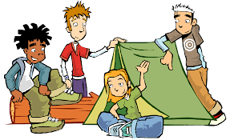
You are group texting with some of your friends that you will be spending the summer with at camp. One individual is a Spanish-speaking exchange student that is new to Sharon and to the camp, so you will have to text in Spanish to make this individual feel as comfortable as possible. Somehow you guys start to talk about what your fears are. You try to ask as many questions as possible so you will have plenty of ideas to be able to scare your friends with throughout the summer.
Ask questions to find out what their fears are.
Answer questions about fears you have and why.
Give as much detail as possible. Maybe
about a “pesadilla” you once had.
Try to be creative with your questions- don’t just rely on “question word questions.”
Comment on your group members’ answers
Ask many follow up questions.

