Slide 1
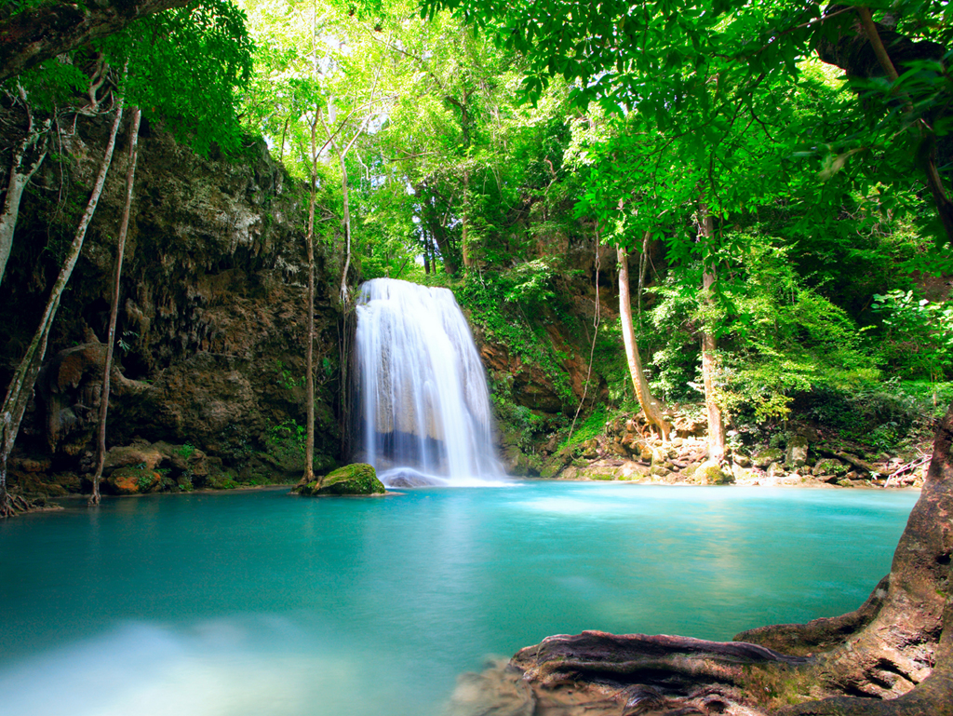
Costa Rica
¡Pura Vida!

Slide 2
El lenguaje

Slide 3
El lenguaje

Slide 4
El Lenguaje

Slide 5
El lenguaje

Slide 6
El lenguaje

Slide 7
El lenguaje

Slide 8
El Servicio

Slide 9
El Servicio

Slide 10
El Servicio

Slide 11
El Servicio

Slide 12
El Servicio

Slide 13
La Adventura

Slide 14
La Adventura

Slide 15
La Adventura

Slide 16
La Adventura

Slide 17
Las Familias
They have experience working with adolescents “extranjeros.”
They are “campesinos.” They are very humble, welcoming people and they really want to get to know your child.
Some families form relationships with their student that last a lifetime.

Slide 18
Las Casas
The are simple houses but do have all the appropriate accommodations to be able to receive student volunteers.
The tour company will try as much as possible to house students in pairs with families throughout the village.
They generally have one bathroom, a living space, a dining area, 3 bedrooms and a patio.

Slide 19
La Alimentación (comida)
The diet will be a traditional Costa Rican diet. It will consist of rice, beans, vegetables, fruits and some protein.
In the case of a specific diet restriction the student should bring their own supplements.

Slide 20
La Zona de los Santos
It is a charming area that is surrounded by nature, crystal rivers, impressive waterfalls, coffee y fruit fields.
It is a safe area and the students will be working with individuals that have many years of experience working with student volunteers. The organization has over 11 years of experience.

Slide 21
Emergencia
In the case of an emergency there is a protocol in place through “Green Communities” regarding appropriate transportation to the closest clinic.
Malaria – there are no cases of malaria in the zone that we are visiting but this is left to the discretion of the parents. The recommendation of “Green Communities” is that the student bring insect repellent, sunblock, a hat and to dress in layers. It can get cold at night.

Slide 22
El Precio
Everything included: $3300.00 (price subject to change)
- Airport transfers in U.S. and Costa Rica
- All in-country transportation
- Lodging (hotels and homestay)
- 3 daily meals
-Spanish classes and materials
- Cultural activities, lectures and weekend excursions
- Professional full-time staff
-Service work and materials
- Pre-departure materials and support
-Tip money
- Airline ticket

Slide 23
Deadline
All applications need to be received by December 5th, 2014

Slide 24
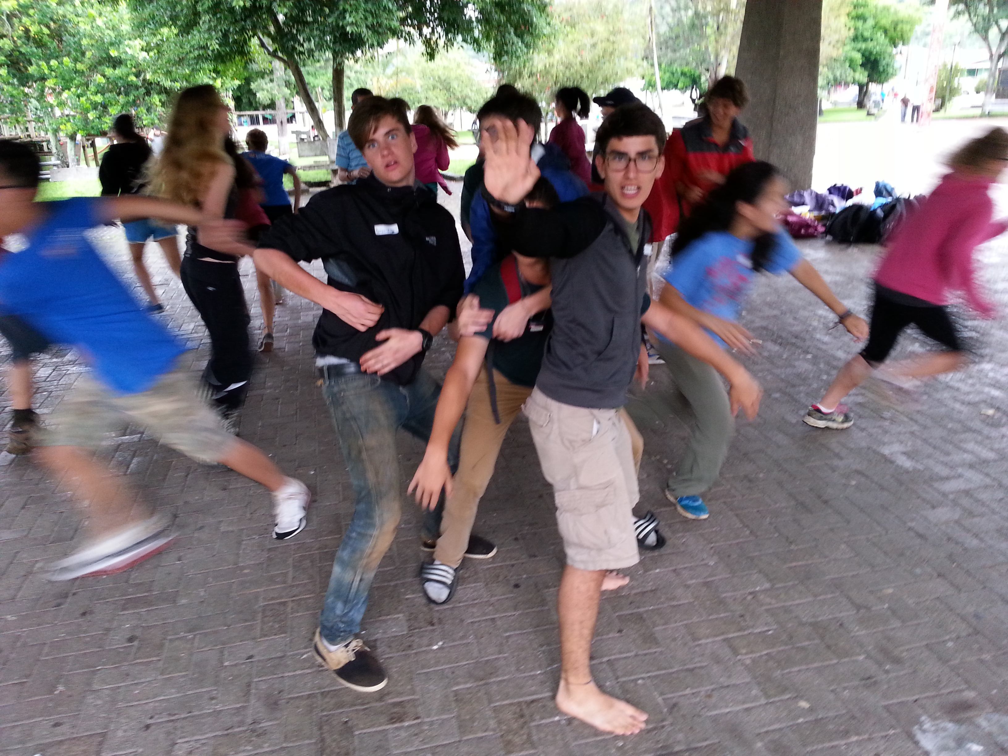
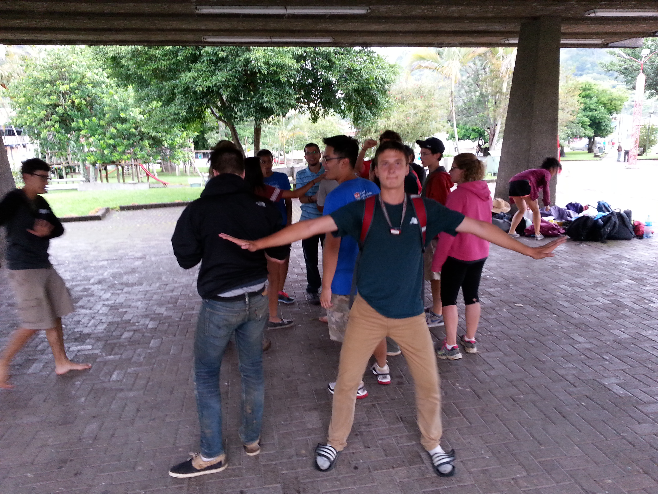
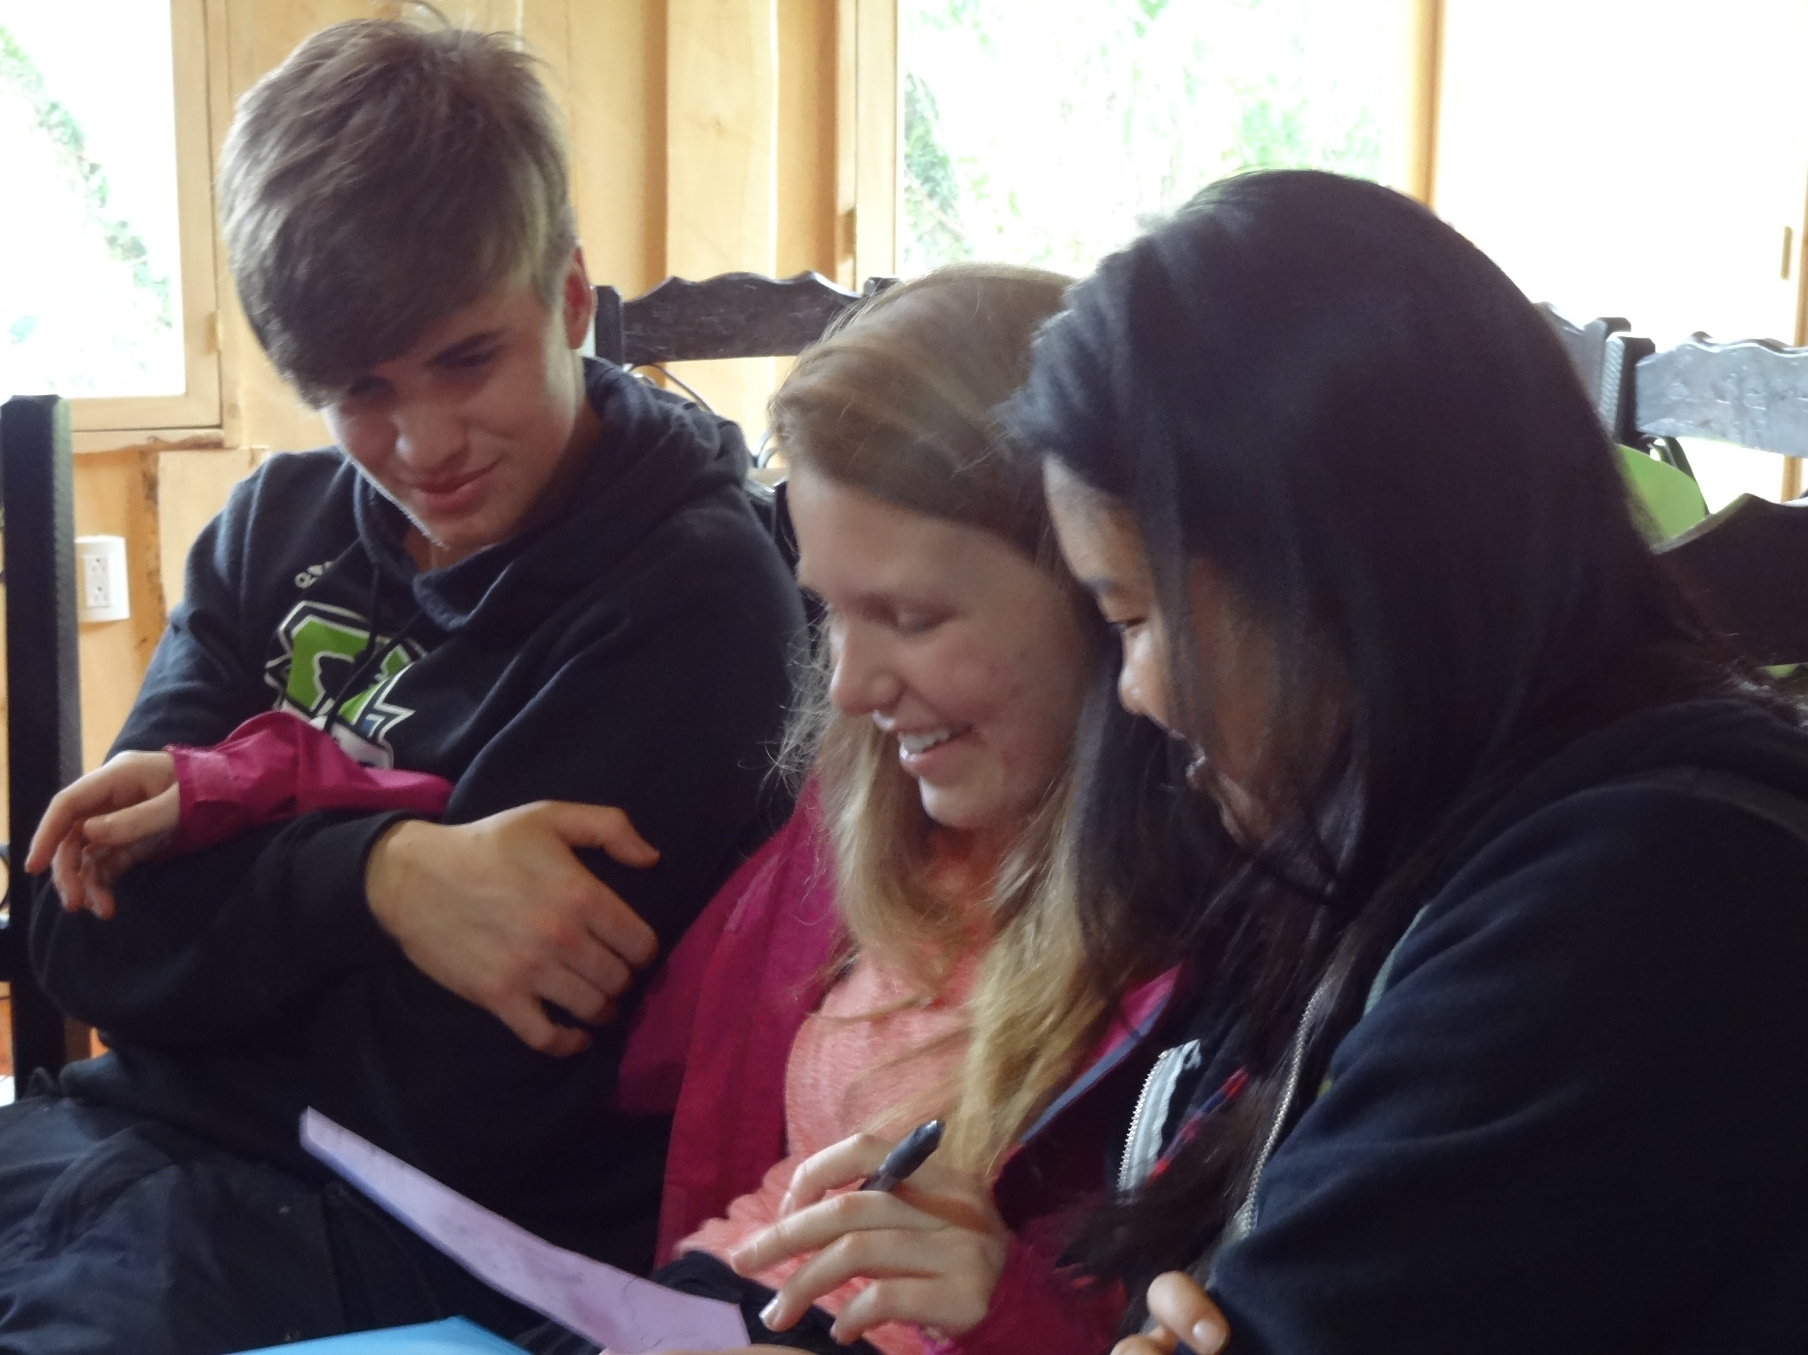
Viva
Costa Rica

