Slide 1
Bienvenidos a la clase de Español
Abigail Theberge

Slide 2
Mis Metas (goals)
challenge myself along with my students
help students reach their potential and provide the tools and environment needed to help them to become responsible for their learning.
I also look forward to evolving my own teaching as the profession itself evolves by always doing research on the most effective ways to teach a world language.

Slide 3
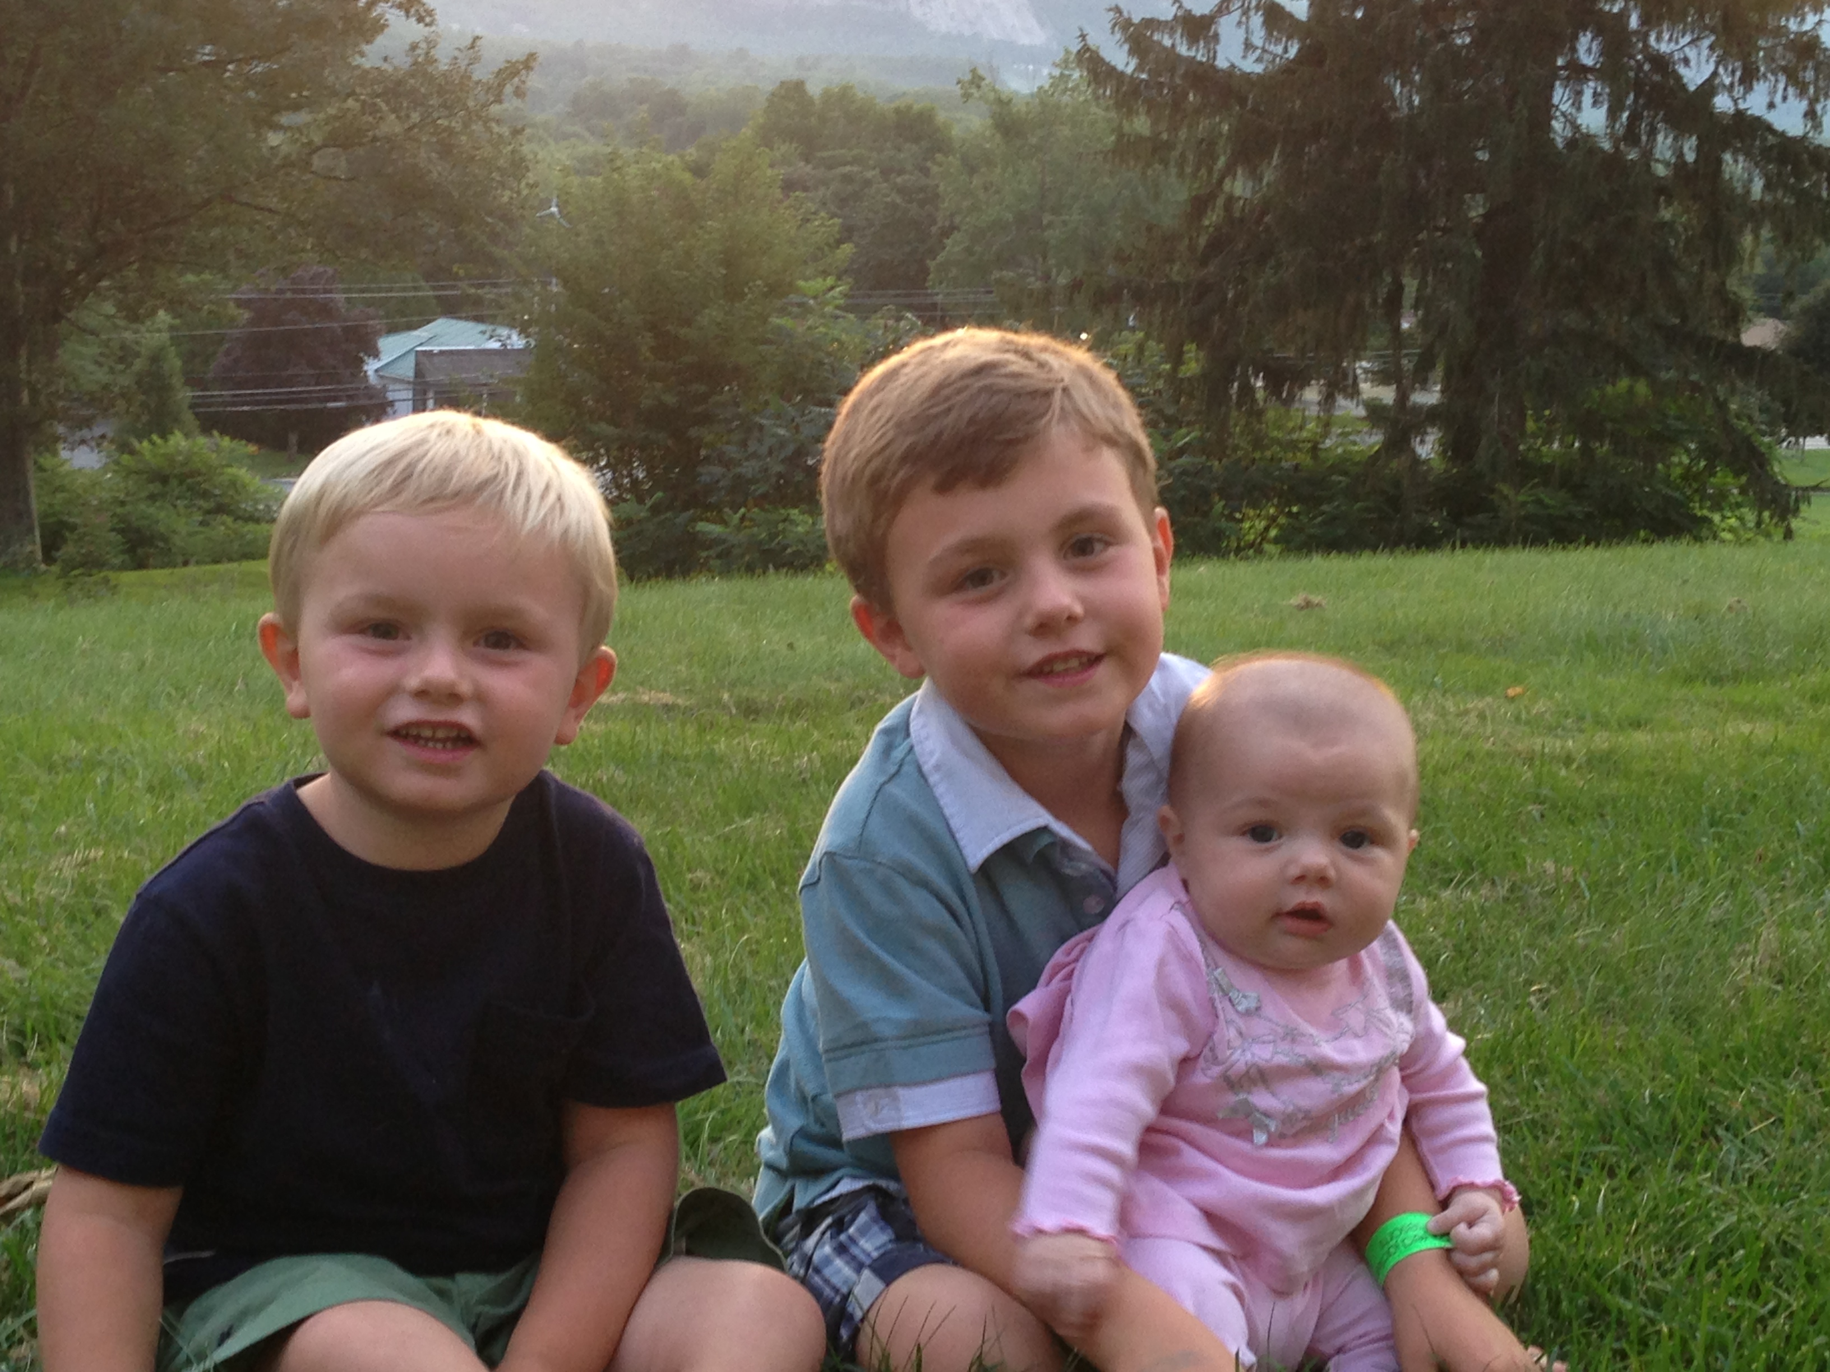
Graduated from St. Michael’s College with Psychology degree
Received my Master’s degree from Middlebury College in Spanish
Received my M.A.T. from the University of Massachusetts
Best accomplishment to date… Mis tres hijos

Slide 4
How to be Successful
Take chances!
Communicate with the teacher!
Put in the effort…it will be worth it!
Don’t wait for the bar to raise … raise it yourself!
Check the teacher website and “edmodo” regularly!
If at all overwhelmed, confused or unsure come and talk to the teacher!

